Slide 1

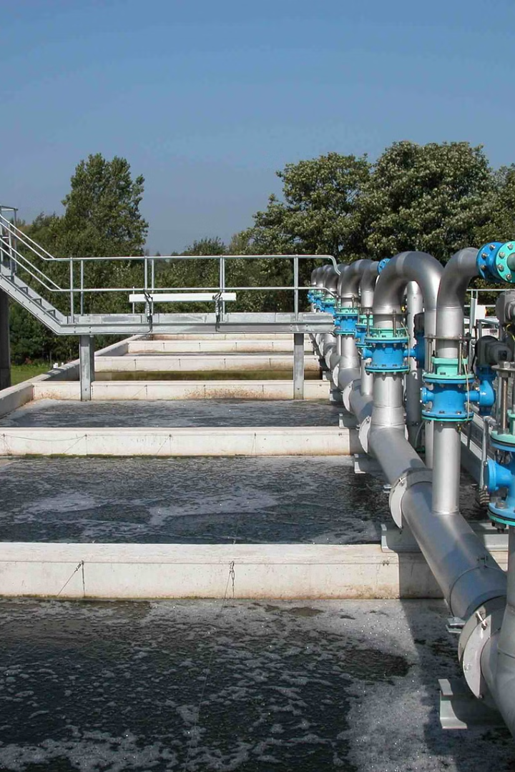

CE 208 Mini project
UNDERSTANDING AND EVALUATING EFFICIENCY OF REMEDIATION VARIOUS BACTERIAL AND FUNGAL METABOLISMS IN WASTE WATER
Presented by:
4010 - Anuj jain
4014 - Atul Baghel
4015 - Avudoddi Hemanth
4016 - Biradhar Saketh
4017 - Edula Charmi

Slide 2
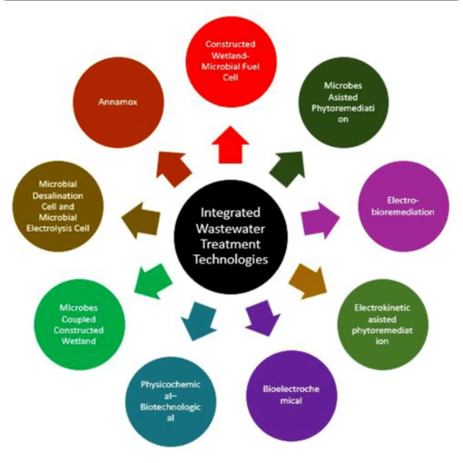
INTRODUCTION
NEEDS & POSSIBLE ADVANCEMENTS IN WASTE WATER TREATMENT
DIFFERENT WATER TREATMENT TECHNOLOGIES
SOURCE:https://www.researchgate.net/figure/Various-integrated-environmental-technology-used-for-wastewater-treatment-and_fig1_359495200
Wastewater treatment aims to accelerate natural cleansing processes, removing contaminants for environmental health. Biological treatment, utilizing microbial action, targets organic pollutants and nutrients but faces challenges like low efficiency. Integrated strategies combining biological, physical, and chemical methods address efficiency and energy consumption concerns. Safeguarding surface waters, crucial for drinking water in countries like Sweden, requires stringent measures against chemical contamination.
Percentage-wise adoption of different water treatment technologies
Scope and need of the study
Types of Bacteria
Water treatment using Aerobic bacteria
Filamentous bacteria for Activated sludge process
Bacterial metabolisms
Fungal metabolisms for water treatment
Research findings on fungal metabolisms for water treatment
Other methods of water treaatment
Conclusion and Future Outlook
Refrences

Slide 3
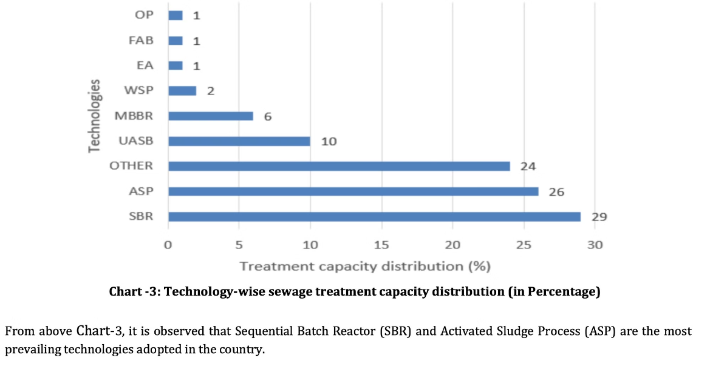
Percentage-wise adoption of different water treatment technologies
Source:https://www.google.com/url?sa=t&rct=j&q=&esrc=s&source=web&cd=&ved=2ahUKEwix-Iia9cmFAxULgFYBHVXOAokQFnoECDgQAQ&url=https%3A%2F%2Fwww.irjet.net%2Farchives%2FV9%2Fi6%2FIRJET-V9I638.pdf&usg=AOvVaw25QWjN7fEiUGNDpA4asyWo&opi=89978449

Slide 4
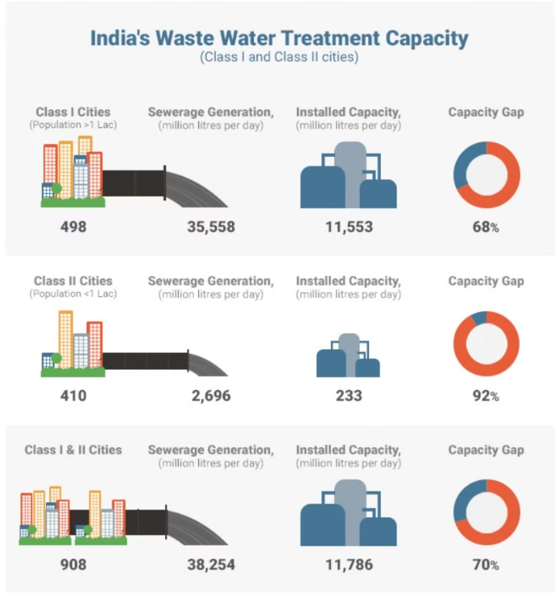
Scope and need of the study
Current Status: Indian water treatment capacity stands at 27.3%, with sewage treatment at 18.6%; despite recent improvements to 23.8%, a significant portion of wastewater remains untreated or partially treated, especially in urban areas.
Solution: Assessing the impact of biological methods on Biological Oxygen Demand (BOD5) removal efficiency, typically ranging from 90% to 98% in activated sludge processes.
Source:https://doi.org/10.2166/washdev.2013.099

Slide 5



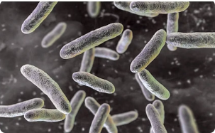
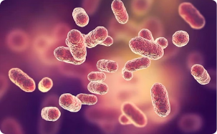
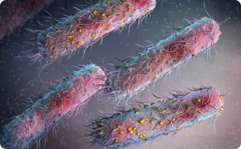
Types of Bacteria
In wastewater treatment plants, bacteria act as nature's custodians, breaking down organic matter, consuming pollutants, and transforming them into harmless byproducts.
There are mainly 2 types of bacteria
Aerobic bacteria
Anerobic bacteria
Facultative bacteria
Aerobic bacteria thrive in oxygen-rich environments and play a crucial role in breaking down organic compounds through aerobic respiration.
Anaerobic bacteria, on the other hand, flourish in oxygen-deprived conditions, aiding in the decomposition of organic matter in the absence of oxygen.
Faculative bacteria are versatile multitaskers which are capable of adapting to both aerobic and anaerobic conditions as needed.
Bacteria Sphingomonas
Porphyromonas gingivalis bacteria
enterobacteria
Source:https://www.shutterstock.com/image-illustration/bacteria-sphingomonas-scientific-3d-illustration-gramnegative-2105623736
Source:https://www.shutterstock.com/image-illustration/porphyromonas-gingivalis-bacteria-3d-illustration-anaerobic-768848566
Source:https://www.shutterstock.com/image-illustration/porphyromonas-gingivalis-bacteria-3d-illustration-anaerobic-768848566

Slide 6
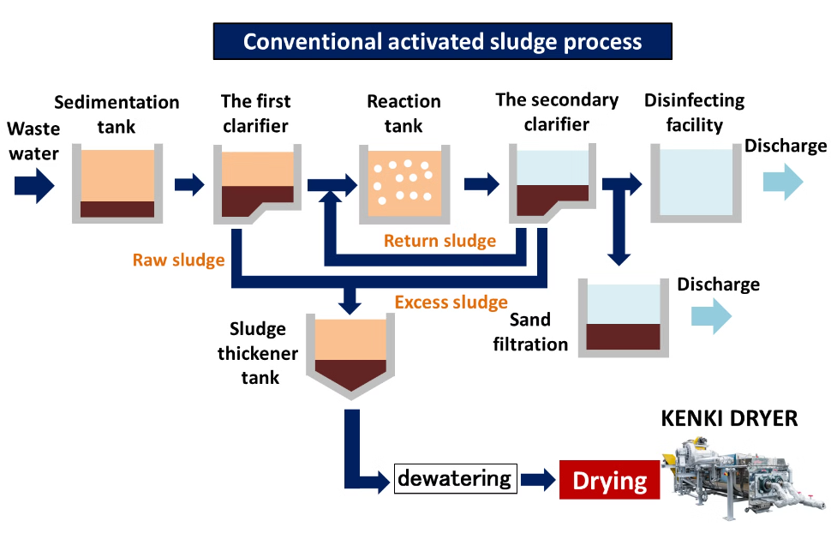
Water treatment using Aerobic bacteria
(Activated Sludge Process)
Source:https://kenkidryer.com/2020/03/14/about-conventional-activated-sludge/
Primary treatment, sedimentation tanks allow gravity to separate solid waste from liquid, with bacteria aiding in the decomposition of organic solids.
Secondary treatment sees the spotlight shift to biological processes, where bacteria thrive in aeration tanks, breaking down dissolved organic matter.
Tertiary treatment involves further purification, with bacteria assisting in nutrient removal and polishing the effluent to meet stringent environmental standards.

Slide 7
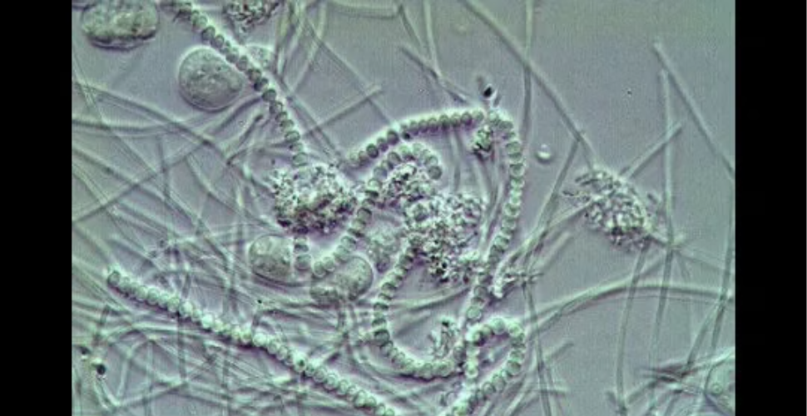
Filamentous bacteria for Activated sludge process
Source:https://www.environmentalleverage.com/What_are_filaments.htm
Efficiency in the activated sludge process relies heavily on sludge settleability, affected by filamentous bacteria causing sludge bulking and foaming. Despite efforts in plant design, these issues persist in industrial wastewater treatment plants (WWTPs), prompting research into identifying and characterizing filamentous bacteria for targeted control (Nielsen, 1998). Traditionally, filamentous bacteria were identified via light microscopy and staining reactions (Eikelboom, 1975; Jenkins, 1993). Enrichment and genetic sequencing have expanded understanding, with rRNA probes enabling rapid detection (Erhart, 1997; de los Reyes, 1998; Kanagawa, 2000). Full-cycle rRNA approaches and fluorescence in situ hybridization (FISH) probes reveal diverse filament physiology (Juretschko, 2002; Nielsen, 1998).

Slide 8
Bacterial metabolisms
Aerobic Bi of odegradation :In aerobic treatment processes such as activated sludge and aerobic biofilters, bacteria metabolize organic matter in the presence oxygen. They break down complex organic compounds into simpler forms such as carbon dioxide, water, and biomass. This process reduces the organic load in the wastewater, making it less harmful to the environment.
Nitrogen removal: Nitrogen compounds such as ammonia and nitrate are common pollutants in wastewater. Certain bacteria, such as Nitrosomonas and Nitrobacter, are involved in nitrification, where ammonia is oxidized to nitrite and then to nitrate. Other bacteria, such as denitrifying bacteria (Pseudomonas), facilitate denitrification, converting nitrate into nitrogen gas, which is released into the atmosphere, thus removing nitrogen from the wastewater.
Phosphorous removal: Phosphorus is another nutrient that can contribute to eutrophication if present in high concentrations in water bodies. Certain bacteria, known as polyphosphate-accumulating organisms (PAOs), can store phosphorus within their cells as polyphosphate granules. In biological nutrient removal processes, such as enhanced biological phosphorus removal (EBPR), these bacteria help remove phosphorus from wastewater through uptake and subsequent removal in the sludge.
Anaerobic biodegradation: In anaerobic treatment processes such as anaerobic digestion and anaerobic lagoons, bacteria degrade organic matter in the absence of oxygen. Anaerobic bacteria break down complex organic compounds into methane, carbon dioxide, and other byproducts. This process is particularly useful for treating high-strength organic wastes and producing biogas as a renewable energy source.
Bioaugmentation: Specific strains of bacteria or bacterial consortia are introduced into wastewater treatment systems to enhance metabolic activities and improve treatment efficiency. Bioaugmentation can help accelerate the degradation of certain recalcitrant pollutants or optimize nutrient removal processes.

Slide 9
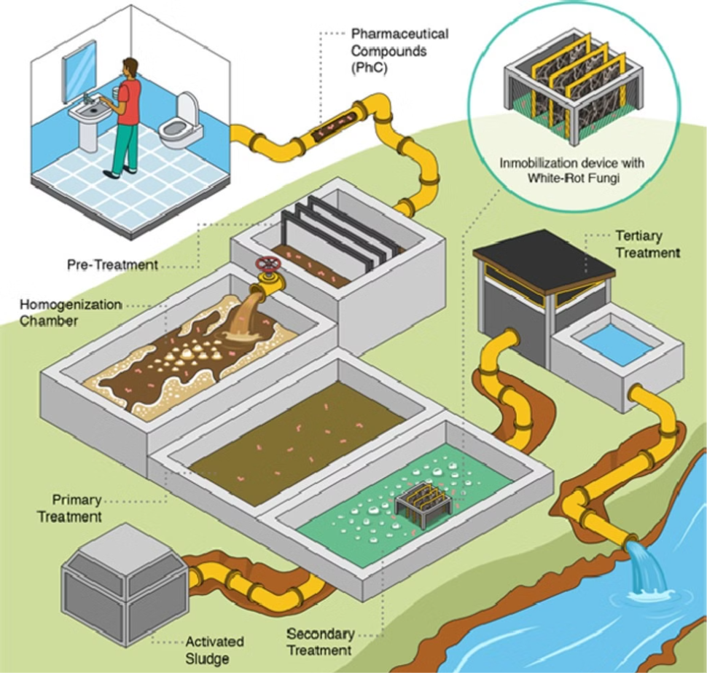
Fungal metabolisms for water treatment
Source:https://www.sciencedirect.com/science/article/pii/S2666765721000429

Slide 10
Research findings on fungal metabolisms for water treatment
Research by Thanh and Simard (1973a) identified Trichothecium roseum as a promising fungal strain for wastewater treatment. It showed high efficiency in removing phosphate and nitrogen from household wastewater. Additionally, the study determined the ideal pH and temperature ranges for fungal growth during nitrogen removal.
Hiremath et al. (1985) used seven fungal species from a wastewater pond in batch trials to boost fungal output for potential consumption. They employed filter-sterilized wastewater over ten days at room temperature. Despite slightly lower organic matter removal compared to nutrient removal, results aligned with earlier findings, confirming fungi's viability for wastewater treatment and resource generation.
: Fungi, particularly white-rot fungi like Phanerochaete chrysosporium, are effective in breaking down cellulose and lignin, making them valuable in treating wastewater from various industries. brown-rot fungi can be used for cellulose degradation and white-rot fungi for lignin degradation.

Slide 11
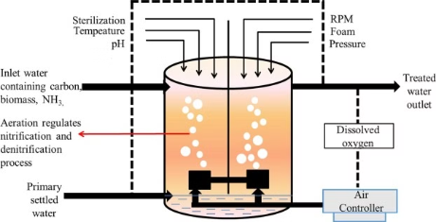
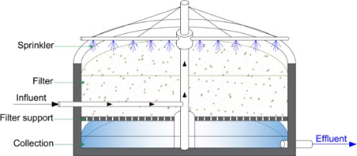
Other methods of water treaatment
NITRIFICATION
TRICKLING FILTERS
Source:https://www.sciencedirect.com/topics/earth-and-planetary-sciences/trickling-filter
Source:https://www.sciencedirect.com/science/article/abs/pii/S0960852419304286
Trickling filters are a kind of biological wastewater treatment technology that cultivates microorganisms that degrade organic pollutants on a bed of media made of rocks or plastic packaging.
In wastewater treatment, nitrification is the process by which poisonous ammonia (NH3) is changed by aerobic microbial activities into less toxic nitrate (NO3₃⁻).
It is essential for lowering wastewater's nitrogen content, avoiding environmental contamination, and preserving the quality of the water in receiving bodies of water.
The media's surface is trickling with wastewater, which enables the microbes to adhere and create a biofilm. Organic contaminants are naturally broken down when the wastewater flows through the biofilm.
In the secondary treatment phase of wastewater treatment facilities, specialised bacteria oxidise ammonia to nitrite and subsequently to nitrate in the presence of oxygen. This process is known as nitrification.
Trickling filters are usually aerobic, which means that the microbial breakdown process depends on oxygen. After treatment, the wastewater is gathered at the filter's bottom and either processed further or released.

Slide 12
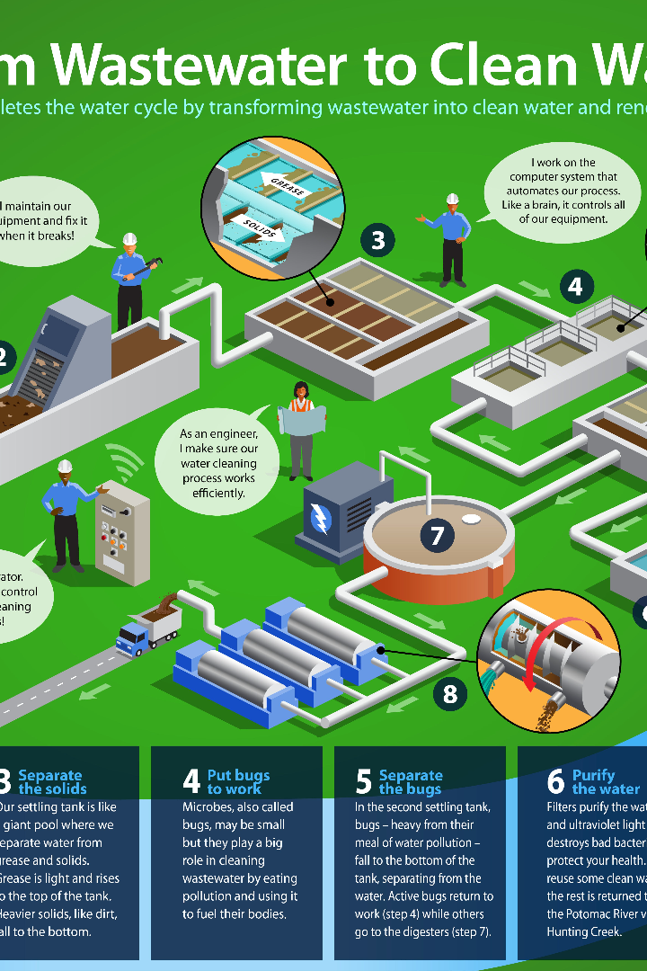
Conclusion and Future Outlook
Finally, our research demonstrated how well bacterial and fungal metabolisms work to remediate wastewater. We discovered that these microbes had a variety of metabolic pathways that enable them to effectively break down organic contaminants. Promising results in pollutant reduction were observed in our evaluation, highlighting the environmentally sustainable nature of microbial-based treatment techniques. Future studies in this field may produce cutting-edge bioremediation techniques to deal with the problems associated with water contamination.

Slide 13
Refrences
et al Arvind Chavhan 5, July - 2012
et al D. D. FOCHT AND A. C. CHANG
Frederic Seguret et al (First received 1 September 1997; accepted in revised form 1 July 1999)

